Slide 1


Name: Sergio Pinto

Slide 2

Outline
Executive Summary
Introduction
Methodology
Results
Conclusion
Appendix

Slide 3
Executive Summary
Summary of methodologies
Our approach encompassed a dual methodology involving API integration and web scraping techniques for data collection. Following the acquisition phase, we employed a suite of Python Data manipulation methods to meticulously process and cleanse the dataset. Subsequently, SQL queries were garnered through systematic data visualization and trend analysis. Concluding our analytical framework, we implemented supervised machine learning models to make predictions about the success of the landing event.
Summary of all results
Through meticulous data analysis, we identified discernible patterns and correlations among variables directly influencing the success of landing events. Leveraging these insights, we developed and trained a predictive model that demonstrated a notable capability to accurately forecast the probability of a successful landing event. Notably, the model achieved a commendable accuracy rate of 83%, underscoring its effectiveness in providing reliable prognostications within this domain.

Slide 4
Introduction
• SpaceX’s commitment to reusable rockets has significantly mitigated space travel
costs by strategically focusing on the retrieval of the first rocket phase. The
recovery of this initial phase is paramount in preserving and reusing expensive
components, contributing directly to cost reduction. An in-depth analysis of the
success rate of these retrieval events serves as a valuable metric for evaluating
efficiency and cost-effectiveness in SpaceX’s pioneering approach. This particular
project is geared towards predicting the success of the first phase retrieval event,
thereby offering predictive insights aimed at enhancing decision-making within the
space industry.

Slide 5

Section 1

Slide 6
Methodology
Executive Summary
Data collection methodology:
Describe how data was collected
Perform data wrangling
Describe how data was processed
Perform exploratory data analysis (EDA) using visualization and SQL
Perform interactive visual analytics using Folium and Plotly Dash
Perform predictive analysis using classification models
How to build, tune, evaluate classification models

Slide 7
Data Collection
Describe how data sets were collected:
Data was first collected using SpaceX API (a RESTful API) by making a get request to the SpaceX API. This was done by first defining a series helper functions that would help in the use the API to extract information using identification numbers in the launch data and the requesting rocket launch data from the SpaceX API URL.
Finally, to make the requested JSON results more consistent, the SpaceX launch data was requested and parsed using the GET request and the decoded the response content as aJson result which was then converted into a Pandas data frame.

Slide 8
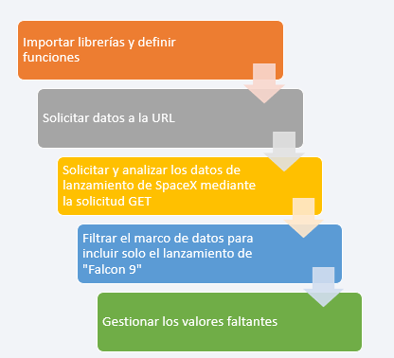
Data Collection – SpaceX API
Define auxiliary function to parse the data.
Retrieve data from the REST API using the method GET.
Parse the data with the previously built auxiliary functions.

Slide 9
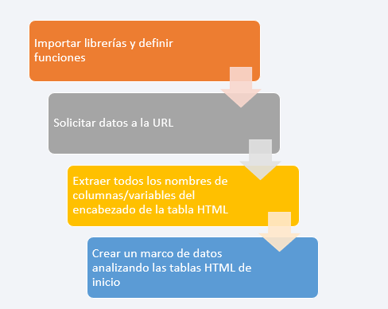
Data Collection - Scraping
Using the get request.get method to download page code.
Created a BeutifulSoup object to manipulate the html text.
Filtered the desired tables using soup manipulation methods.
Converted the data from the HTML to pandas Data Frame format.

Slide 10
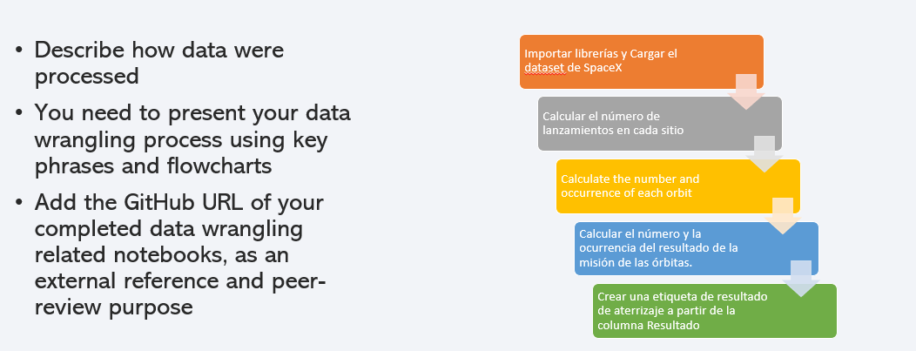
Data Wrangling

Slide 11
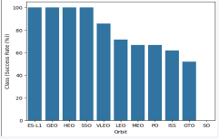
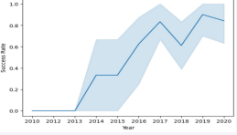
EDA with Data Visualization
Explored the data by visualizing the relationship between flight number and launch Site, payload and launch site, success rate of each orbit type, flight number and orbit type, the launch success yearly trend.

Slide 12
EDA with SQL
Using SQL, we had performed many queries to get better understanding of the dataset
- Displaying the names of the launch sites.
- Displaying 5 records where launch sites begin with the string ‘CCA’.
- Displaying the total payload mass carried by booster launched by NASA (CRS).
- Displaying the average payload mass carried by booster version F9 v1.1.
- Listing the date when the first successful landing outcome in ground pad was achieved.
- Listing the names of the boosters which have success in drone ship and have payload mass greater than 4000 but less than 6000.
- Listing the total number of successful and failure mission outcomes.
- Listing the names of the booster versions which have carried the maximum payload mass.
- Listing the failed landing outcomes in drone ship, their booster versions, and launch sites names for in year 2015.- Rank the count of landing outcomes or success between the date 2010-06-04 and2017-03-20, in descending order.

Slide 13
Build an Interactive Map with Folium
We marked all launch sites, and added map objects such as markers, circles, lines to mark the success or failure of launches for each site on the folium map.
We assigned the feature launch outcomes (failure or success) to class 0 and 1.i.e., 0for failure, and 1 for success.
Using the color-labeled marker clusters, we identified which launch sites have relatively high success rate.
We calculated the distances between a launch site to its proximities. We answered some question for instance:
Are launch sites near railways, highways and coastlines.
- Do launch sites keep certain distance away from cities.

Slide 14
Build a Dashboard with Plotly Dash
We built an interactive dashboard with Plotly dash.
We plotted pie charts showing the total launches by a certain sites.
We plotted scatter graph showing the relationship with Outcome and PayloadMass (Kg) for the different booster version.

Slide 15
Predictive Analysis (Classification)
We loaded the data using numpy and pandas, transformed the data, split our data into training and testing.
We built different machine learning models and tune different hyperparameters using GridSearchCV.
We used accuracy as the metric for our model, improved the model using feature engineering and algorithm tuning.
We found the best performing classification model.

Slide 16
Results
Exploratory data analysis results
Interactive analytics demo in screenshots
Predictive analysis results

Slide 17

Section 2

Slide 18
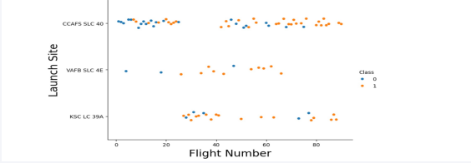
Flight Number vs. Launch Site
From the plot, we found that the larger the flight amount at a launch site, the greater the success rate at a launch site.

Slide 19
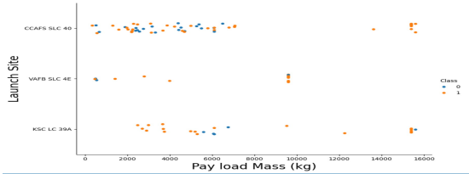
Payload vs. Launch Site
The greater the payload mass for launch site CCAFS SLC 40 the higher the success rate for the rocket.

Slide 20
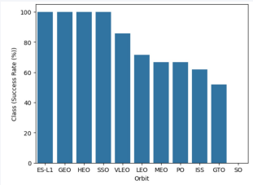
Success Rate vs. Orbit Type
From the plot, we can see that ES-L1, GEO, HEO, SSO, VLEO had the most success rate.

Slide 21
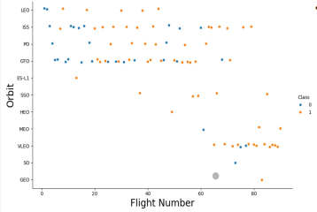
Flight Number vs. Orbit Type
The plot below shows the Flight Number vs. Orbit type. We observe that in the LEO orbit, success is related to the number of flights whereas in the GTO orbit, there is no relationship between flight number and the orbit.

Slide 22
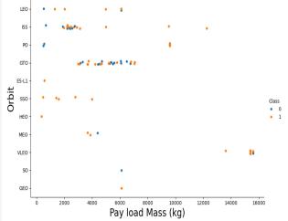
Payload vs. Orbit Type
We can observe that with heavy payloads, the successful landing are more for PO,LEO and ISS orbits

Slide 23
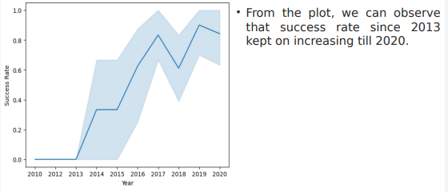
Launch Success Yearly Trend

Slide 24
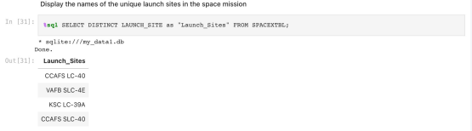
All Launch Site Names
We used the key word DISTINCT to show only unique launch sites from the SpaceX data.

Slide 25
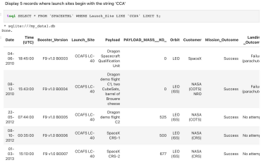
Launch Site Names Begin with 'CCA'
We used the query above to display 5 records where launch sites begin with CCA.

Slide 26
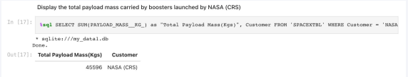
Total Payload Mass
We calculated the total payload carried by boosters from NASA as 45596 using the query below.

Slide 27
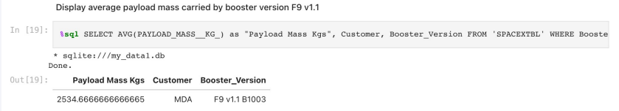
Average Payload Mass by F9 v1.1
We calculated the average payload mass carried by booster version F9 v1.1 B1003 as 2534.66666666666.

Slide 28
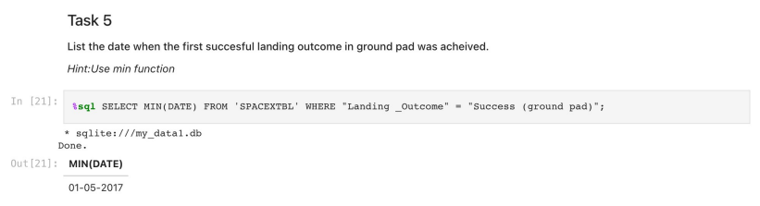
First Successful Ground Landing Date
We observed that the dates of the first successful landing outcome on ground pad was 1st May 2017.

Slide 29
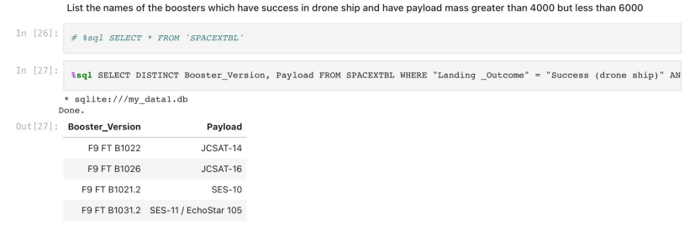
Successful Drone Ship Landing with Payload between 4000 and 6000
We used the WHERE clause to filter for boosters which have success fully landed on drone-ship and applied the and condition to determine successful landing with payload mass greater than 4000 but less than 6000.

Slide 30
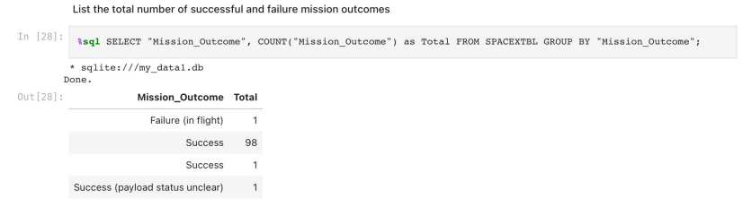
Total Number of Successful and Failure Mission Outcomes
Total number of Mission outcome was a success or a failure.

Slide 31
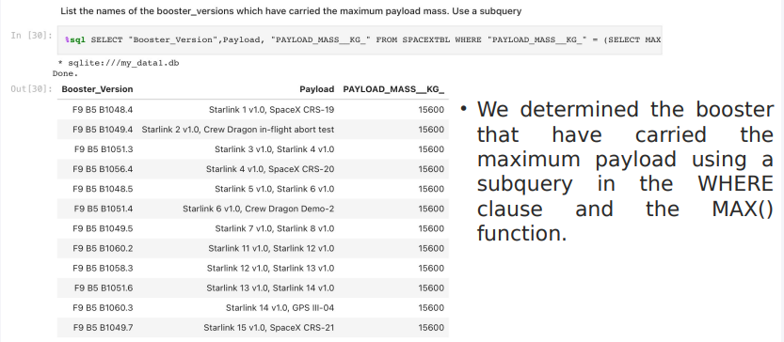
Boosters Carried Maximum Payload

Slide 32
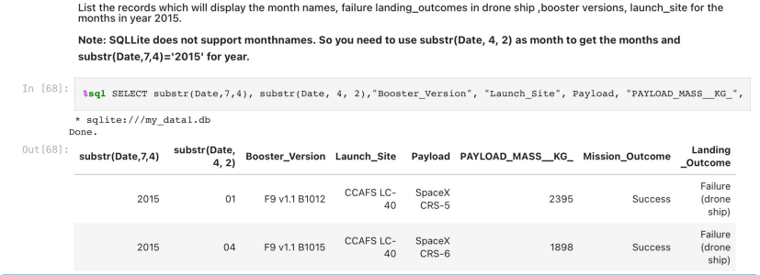
2015 Launch Records
We used a combinations of the WHERE clause, LIKE, AND, and Between conditions to filter for failed landing outcomes in drone ship, their booster versions, and launch site names for year 2015.

Slide 33
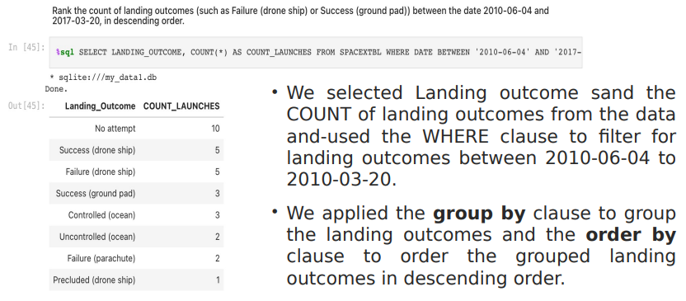
Rank Landing Outcomes Between 2010-06-04 and 2017-03-20

Slide 34

Section 3

Slide 35
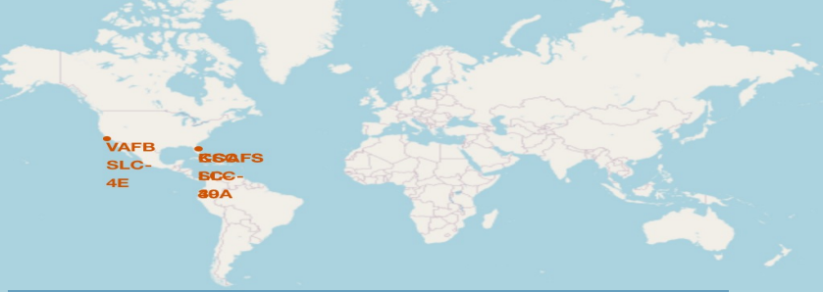
All launch sites global map markers
We can see that the Space launch sites are in the United States of America coasts. Florida and California.

Slide 36
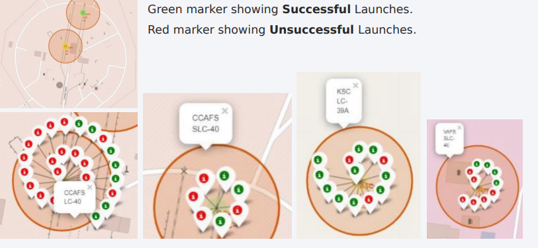
Markers showing launch sites with color labels

Slide 37
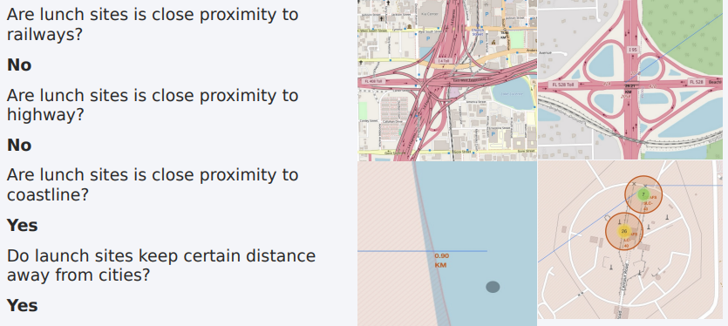
Launch Site distance to landmarks

Slide 38

Section 4

Slide 39
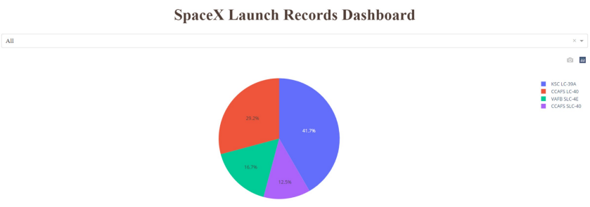
Pie chart showing the success percentage achieved by each launch site
Total success launches by all sites
We can see that KSC LC-39A had the most successful launches from all the sities.

Slide 40
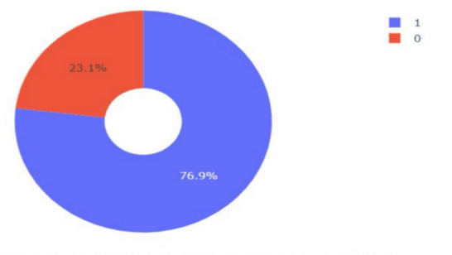
Pie chart showing the Launch site with the highest launch success ratio
KSC LC-39A achieved a 76.9% success rate while getting a 23.1% failure rate

Slide 41
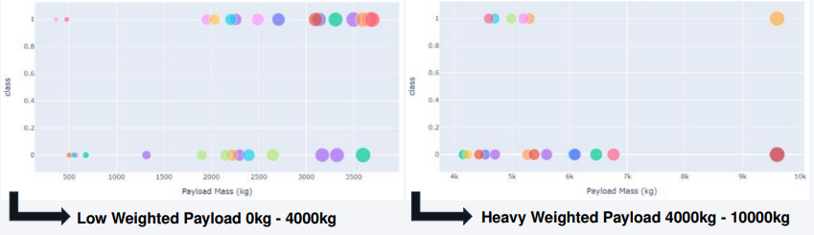
Scatter plot of Payload vs Launch Outcome for all
sites, with different payload selected in the range
slider
We can see the success rates for low weighted payloads is higher than the heavy weighted payloads.

Slide 42

Section 5

Slide 43
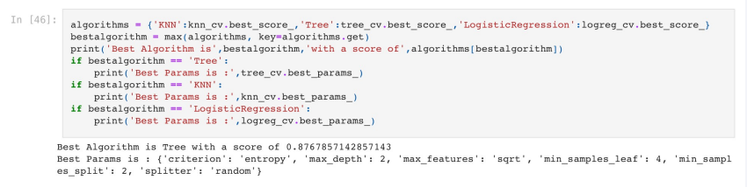
Classification Accuracy
The decision tree classifier is the model with the highest classification accuracy

Slide 44
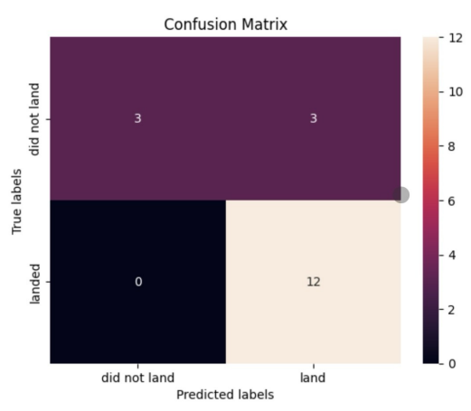
Confusion Matrix
The confusion matrix for the
decision tree classifier shows
that the classifier can distinguish
between the different
classes. The major problem is the false positives .i.e., unsuccessful landing marked as successful
landing by the classifier.

Slide 45
Conclusions
We can conclude that:
The larger the flight amount at a launch site, the greater the success
rate at a launch site.
Launch success rate started to increase in 2013 till 2020.
Orbits ES-L1, GEO, HEO, SSO, VLEO had the most success rate.
KSC LC-39A had the most successful launches of any sites.
The Decision tree classifier is the best machine learning algorithm for
this task.

Slide 46
Appendix
Include any relevant assets like Python code snippets, SQL queries, charts, Notebook outputs, or data sets that you may have created during this project

Slide 47


